Slide 1
Henco – BIM Ready

Slide 2
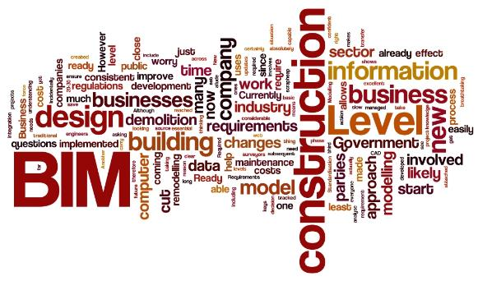
What do you know about BIM?
Question!
What do you know about BIM?
Building Information Modeling
Notes:
Tell us what you know about BIM. What words – terms come to mind when you hear BIM?
Always the last question: What’s in it for me?

Slide 3
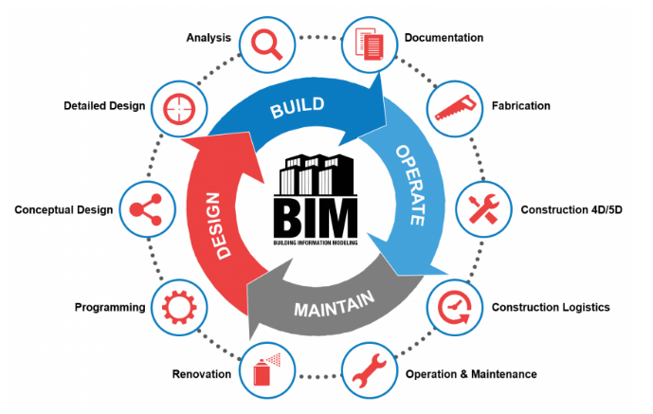
Notes:
BIM is not a program, BIM is not software, BIM is a process.
There is a common misconception that BIM just means 3D design. In fact, it’s much more. BIM is a process for creating and managing all of the information on a project, before, during and after construction.
The output of the process is the Building Information Model, the digital description of every aspect of the built asset.
1: Programming: gather information for the project. Define specifications and needs from the customer
2: Conceptual Design: simulations and visual information for decision makers (possibly including some 2D drawings). Base for decision making on materials, suppliers, …
3: Detailed Design: modelling of the building according to the decisions made in conceptual design.
4: Analysis
5: Documentation
6: Fabrication (pre-fabrication)
7: Construction 4D/5D:
4D: Time schedule
5D: cost of materials and labour
8: Construction Logistics: planning of logistics for the needed materials at a certain time in the process
9: Operation & Maintenance
10: Renovation

Slide 4
What is the manufacturer’s place in BIM?
In BIM -> information is in the middle
Reliable, qualitative data is essential in BIM projects
Manufacturers are the source for product data

Slide 5
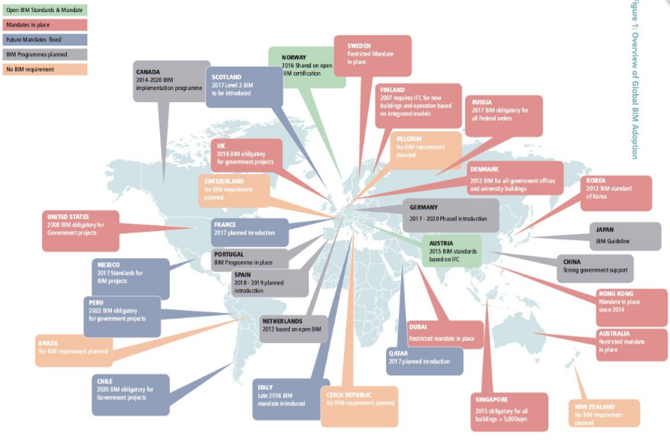
BIM Adoption
Global BIM study BICP – Revision 2: February ‘17
Notes:
The recently published report by Daedal Research, ”Global BIM Market: size, Trends and Forecasts (2016-2020)” reported that th gloabl BIM market is expected to reach almost $8billion by 2020, at a compound annual growth rate of 13% between 2015 and 2020. (Daedal Research, 2016)
The implementation of BIM in the construction industry is accelerating globally. In the UK BIM usage increased from 13% in 2011 to 54% in 2016 amongst all construction professions. While it is recognised that implementation is increasing across many countries, the level of BIM use and the rate it is increasing varies between the different regions.
Governments across the globe are increasingly recognising the efficiencies that can be gained with this change. Learning from leading jurisdictions, governments which are embarking on the transformation journey have been convinced that the strategic use of BIM can support a leaner more innovative construction sector thus addressing declining productivity prevalent in construction (Kelly et al, 2013 and Farmer, 2016)
An overview of BIM adoption is shown in the figure, demonstrating that there is considerable uptake of BIM by governments across the globe.
Currently the governments of the UK, Hong Kong and South Korea have taken an agressive stance with BIM initiatives in recent years, as have the Scandinavian countries who have been working with BIM for over a decade now.

Slide 6
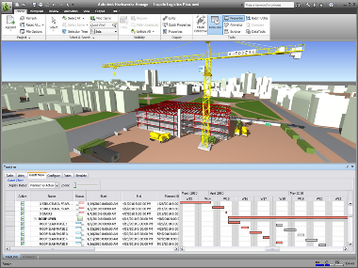
BIM Workflow
3D: 3 dimensional design
4D: Time table and simulation
(virtual presentation in time)
5D: Cost
(Estimation of cost material & labor)
6D: Maintain and Operate
Notes:
The terms 4, 5 and 6D are used to emphasize the possibilities of the application of BIM, beyond ‘just’ the 3D model, throughout the entire building life cycle. It refers to, for example, construction simulations (4D, time); construction cost estimations (5D) or long-term maintenance plans (6D), among other applications.

Slide 7
BIM and Design process
Overall reduce of failure cost
Improves choice of design process
Notes:
For a BIM process the work at the beginning of the process is very high, because you need to specify all the specifications. Throughout the development of the project, the level of difficulty in the process decreases because everything is very well prepared and defined in the beginning.
Working without a BIM process makes that in the beginning, you make rough sketches of the design and start from there. The level of complexity increases throughout the project as the “difficulties” and “issues” are only becoming clear when you face them and they need to be resolved at that moment. This might impact the timing of the project as you can bump into issues that weren’t foreseen and that ask more time than expected.

Slide 8
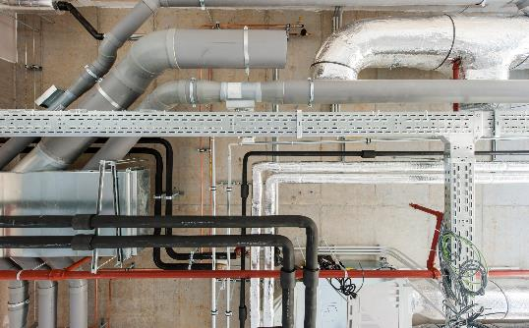
BIM, does it do the magic tric?
Notes:
Everything starts with good data!

Slide 9
BIM features and advantages
Facilitates coordination and collaboration
Clash detection -> time saver
Show cost implications of design changes as they occur
Reduction of errors on site
Building service information available for facilities management
Information transfer between the different phases (design – construction – operation) is smoother
Increases productivity
Notes:
Facilitates coordination and collaboration between the disciplines involved in the design, construction, operation and maintenance of existing buildings. The project team works on the same model, any changes are automatically coordinated
Time is saved, as the coordination checks are reduced or eliminated through clash detection
What is a clash? A clash occurs when elements of different models occupy the same space. A clash may be geometric (for example pipes passing through walls), schedule based (when different aspects of work that are supposed to be sequential are scheduled to occur together or in reverse), or changes/updates not made to drawings.
Show cost implications of design changes as they occur
Errors on site are significantly reduced as information is coordinated and clash detected
Building service information is available for facilities management on completion of the build. No need to create all the necessary information after completion as everything is already available
The information transfer between the phases of design, construction and operation, is smoother, as each discipline adds information to the model
Productivity is increased, as information is retrieved faster and easily

Slide 10
BIM language: How to speak BIM?
BIM Terminology
BIM = Building Information Modeling
BIM Protocol = Document with requirements
LOD = Level of Development
Lod = Level of Detail
BIM Standards = Mostly on local bases and rules
BIM Formats = Revit files RVT, RFA, IFC others….
N.B.S. = National BIM Standard (UK and US)
Software for BIM
- Revit / Autocad
- Archicad
- Many more programs in the BIM workflow.
- Tekla, Plancal Nova, Sketchup,
- Navisworks, Solibri for clashes etc..
- BIM2Field, BIM360, Revit Server and more cloudbased solutions.
Notes:
LOD100: start of design
LOD200-300: information added to the design
LOD400: starting the building of the building. All specs are available
LOD500: all details added to the model: all details added that are important for the operating of the building: operating models, certificates, …

Slide 11
Henco Product Line Placer
Store.mepcontent.com

Slide 12
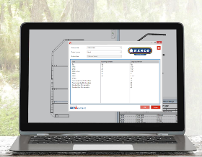
Advantages of a branded Henco App
Showcase our latest products
Unique data insights
Direct contact with engineers globally
BIM adoption of our products in new markets
REVIT based app: Not dependent on other software programs to work with Henco data

Slide 13
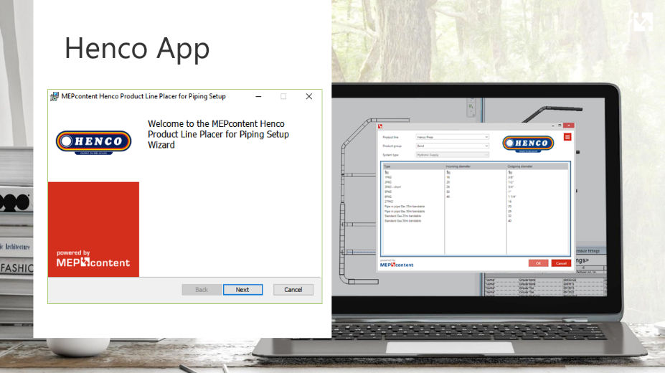

Slide 14
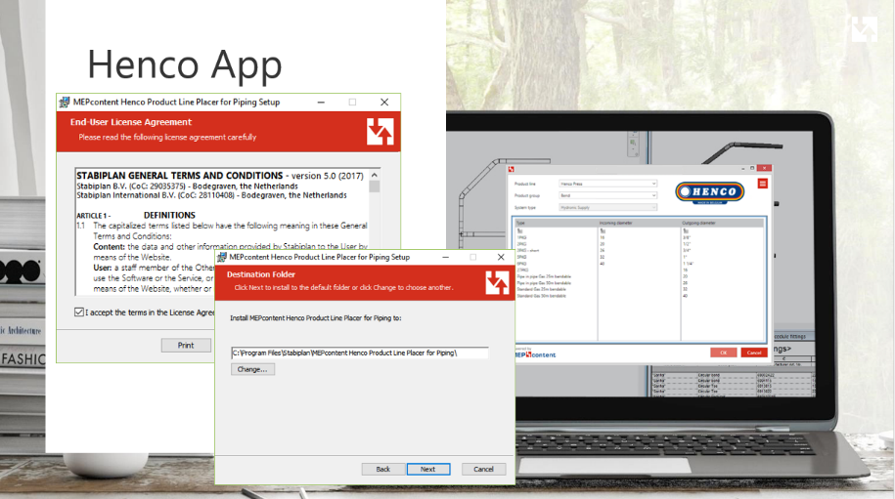

Slide 15
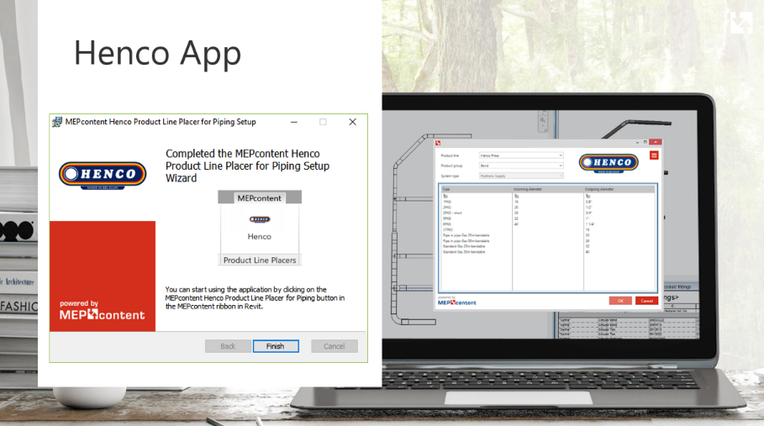

Slide 16
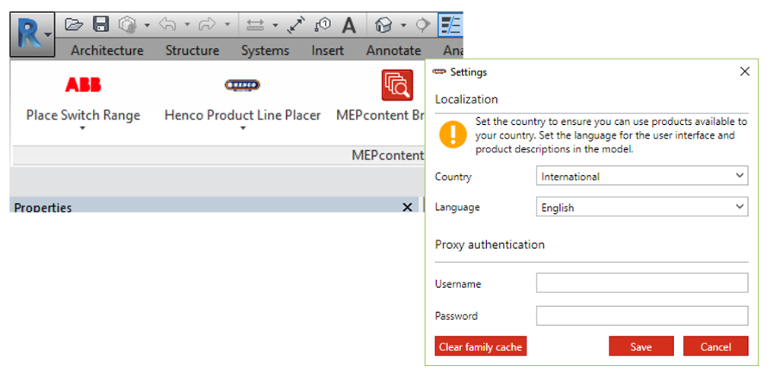
Henco App

Slide 17
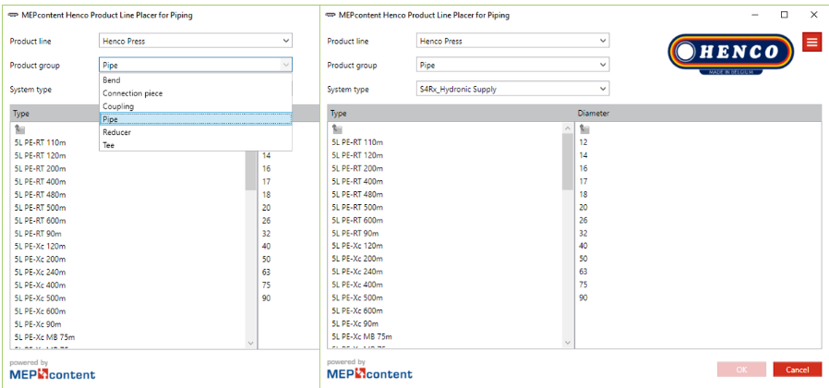
Henco App

Slide 18
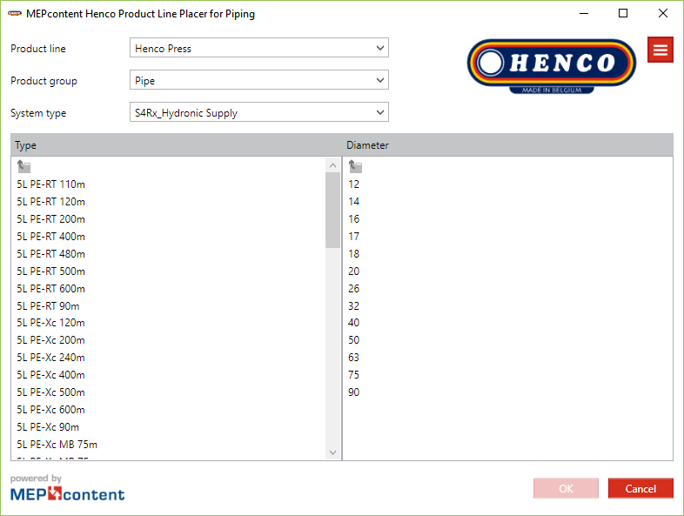
Demo App

Slide 19
Unique advantages of the Henco app
Cloud Based Revit app
Always up-to-date information
No different versions
Easy to maintain
Localized product lines, languages and deeplinks
Newschannel: direct contact with your community
Autorouting
Nodesolver
Notes:
Your equipment products available in one Revit app
Engineers select your products with an intuitive selector
Customers always work with the latest online product data
Enrich your products with technical data and deep links
Measure the success of your app with a real-time dashboard
Autorouting: Revit makes the best possible route and keeps track of the addition of pipes etc that are needed -> works only via the Henco app, not a standard Revit functionality
Nodesolver: asks the engineer to select the area where they want to connect 2 different types of pipes. The it will show which solutions are available in the delivery program

Slide 20
FAQ’s
Q: I don’t have REVIT, can I use the app?
A: The Henco app is designed for Revit
Q: What can I draw with the app?
A: Henco PVDF Press and Henco PVDF Press Gas
Q: What about other portfolio’s?
A: Super Size and Vision will be released later this year
Q: Where can I get support?
A: There is a Help Button available in the App
Product Support via Henco / MEPcontent support via E-mail, Phone
Q: Does it work with other models?
A: The Henco Revit app is a native Revit App. Content placed by the App can be integrated in other models

Slide 21
FAQ’s
Q: Do I need to download other software or Revit content?
A: no, everything you need to draw Henco systems is available through the app
Q: which languages are available?
A: English, French, German, Dutch and Romanian
Other languages will be added later
Q: How do I know I have the correct delivery program?
A: The content is available per localization and can be selected in the settings menu
Q: How do I get the latest version of the app?
A: Henco will keep you up-to-date of new delivery programs or new releases of the application

Slide 22
FAQ’s
Q: Does the app work with all Revit versions?
A: The Henco App will work with Revit 2016, 2017 and 2018
The Henco App does not work on a smartphone/tablet
Q: Why has Henco chosen for Revit?
A: Revit is better in creating and modeling 3D designs
Q: Are there any costs of using the App?
A: No, the app is available for free
Q: Why does Henco release this app?
A: To help you as an engineer to design pipe systems with accurate and up-to- date data in less time. This App will help you in the BIM process to get reliable designs that can be made in practice as designed, with the right article number so they can be ordered and delivered just on time

Slide 23
FAQ’s
Q: Where is my advantage?
A: Always up-to-date information
Easy to maintain
No different version
Localization of products
Node Solver
Autorouting
Q: What do you give me?
A: Free access to Henco data, which is always up-to-date and easy to use
With Henco and the Henco App you are ready for the future!
Let’s go together BIM live!

